Slide 1


Unveiling Insights:
The Dynamic Text Analysis Platform
Our mission is to revolutionize how we understand textual data. This presentation outlines the development of a dynamic text analysis platform designed to transform raw text into actionable insights, driving smarter, faster decisions.
Presented by: Padmanabham Dhanunjay
Notes:
1

Slide 2
TABLE OF CONTENTS
Problem Statement
Project Overview
End-to-End Text Analytics & Insight Generation Architecture Overview
Technology Stack and Development Tools
Dataset Overview and Key Insights
Ingestion and Preparation
Topic Modeling
Sentiment Analysis
Evaluation and Metrics
Summarization
Visualizing Story
Interactive Dashboards
Future Scope and Strategic Enhancements
Notes:
2

Slide 3

Problem Statement
In today’s digital landscape, organizations are flooded with vast amounts of unstructured text—from social media feeds to lengthy technical reports. Manually processing this data is:
Time-Consuming: High volumes of text make manual review impossible at scale.
Subjective: Human analysis often misses subtle patterns or suffers from bias.
Non-Actionable: Most tools provide "what" is happening (data) but fail to explain "why" it matters or "how" to respond (actionable insights).
Notes:
3

Slide 4
Project Overview
This project introduces a comprehensive NLP (Natural Language Processing) platform designed to transform raw, diverse text inputs into strategic assets.
Platform is designed to efficiently process diverse text inputs—whether they’re articles, reports, or social media content—by identifying key themes and summarizing the information into concise, easy-to-understand outputs.
Beyond summarization, the system can offer actionable insights, helping users make quick, informed decisions based on the extracted data. For example, if the analysis highlights customer dissatisfaction, the platform can recommend areas for improvement or deeper investigation.
This system is engineered to save time, enhance decision-making, and deliver tangible value for businesses and individuals.
Analyze
Synthesize
Actualize
Extracting hidden themes using LDA Topic Modeling and Sentiment scores.
Condensing complex reports into concise, high-level summaries.
Generating specific strategic recommendations for decision-makers.
Notes:
4

Slide 5
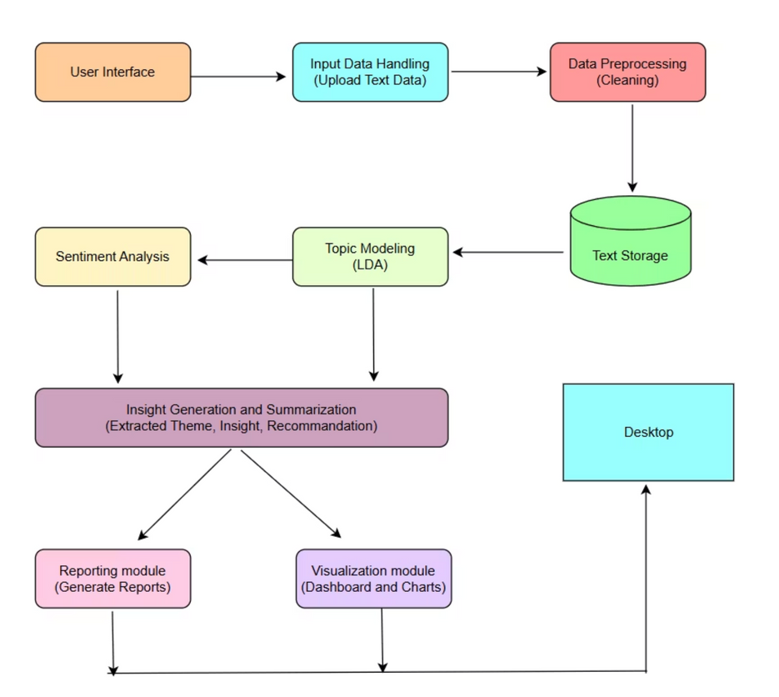
End-to-End Text Analytics & Insight Generation Architecture Overview
Break the diagram into three logical phases:
Data Ingestion & Refining: Taking raw user input and cleaning it through preprocessing to ensure high-quality data storage.
Analysis Layer: Using Topic Modeling (LDA) to find themes and Sentiment Analysis to understand emotional tone.
Actionable Intelligence: Converting raw analysis into summary, specific themes, insights, and recommendations delivered via a dashboard and report.
Notes:
5

Slide 6
Technology Stack and Development Tools
Language & Core Libraries
Natural Language Processing (NLP)
Python: The primary programming language used for its extensive data science ecosystem.
spaCy and NLTK: Employed for Data preprocessing such as Stop word removal and Lemmatization.
Regex (re): Utilized for custom text sanitization and noise removal.
Gensim: Powering the Topic Modeling engine through LDA (Latent Dirichlet Allocation) and Bigram/Trigram detection.
Pandas & NumPy: Used for high-performance data manipulation, cleaning.
Hugging Face Transformers: Provides a state-of-art pre-trained models, crucial for abstractive summarization.
Machine Learning & Modeling
Evaluation & Visualization
Scikit-learn: Open-source Python library for entire machine learning pipeline from data preprocessing to model evaluation.
pyLDAvis: Interactive visualization for analyzing topic distance and keyword relevance.
PyTorch: The underlying deep learning framework used by the BART transformer model for tensor computations.
Matplotlib, Seaborn and wordcloud : Used for generating performance graphs
Streamlit and CSS: Used for building the user-friendly and interactive web interface
Notes:
6

Slide 7
Dataset Overview and Key Insights
Dataset used: Amazon Fine Food Reviews
Scale: 568,454 Total Reviews.
Timeline: 13 Years of Data (1999–2012).
Diversity: 74,258 Unique Products (Coffee, Snacks, Pet Food).
Structure: User IDs, 5-Star Ratings, and Unstructured Text (Contains both Text and Summary).
Reason for Choosing this Dataset
Rich and large scale text data: With 568,454 reviews, it proves the platform can handle industrial-scale data without crashing.
Every review comes with a 1 to 5-star rating. This allows us to verify if our NLP Sentiment Analysis (Positive/Negative) correctly matches the user's actual star rating.
Covers everything from gourmet coffee to pet food, ensuring the Topic Modeling is versatile and not limited to one narrow niche.
Reviews span 13 years, allowing the platform to potentially track how tastes and sentiments change over a decade.
Notes:
7

Slide 8
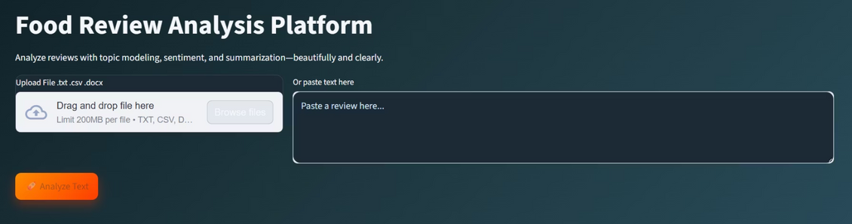
Ingestion and Preparation
Input Module
A user-friendly interface allows seamless uploading of various text data formats, including .txt, .csv, and .docx, or direct text entry ensuring broad compatibility.
Includes checks for null values, empty reviews, and duplicate entries to prevent skewed results.
Text Cleaning
Noise Reduction
Preprocessing
Normalization
Remove unwanted characters.
Tokenization, and Stop word removal.
Lemmatization for consistency.
Why this matters?
Accuracy: Without cleaning, your WordCloud would be filled with words like "the" and "and," which provides zero insight.
Performance: Cleaning reduces the size of the text data, making the Topic Modeling and Sentiment Analysis steps much faster and more accurate.
Consistency: It ensures that "Good," "good," and "GOOD" are all treated as the same data point.
Notes:
8

Slide 9
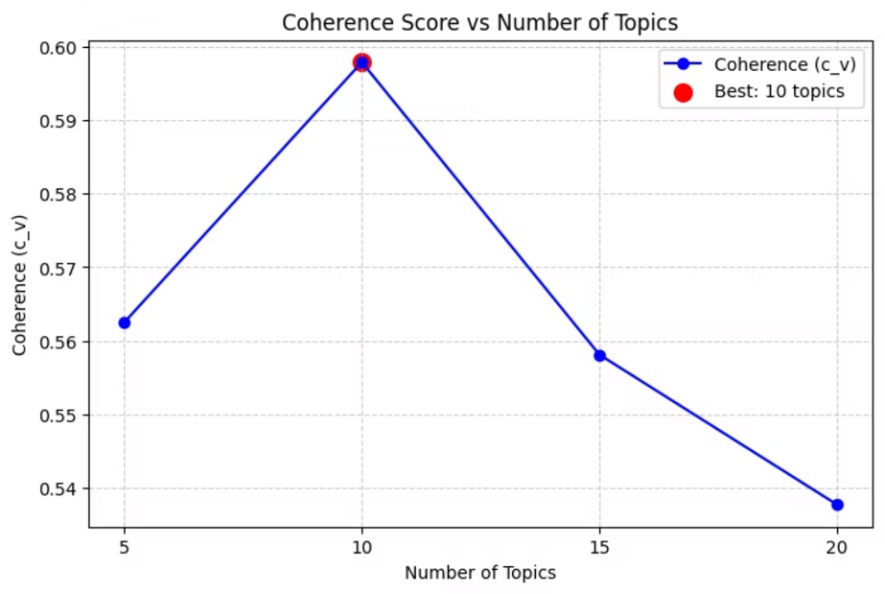
Topic Modeling
Topic modeling automatically discovers hidden themes or abstract topics within large collections of text documents by identifying clusters of words that frequently appear together, helping to organize, understand, and summarize vast amounts of unstructured text data.
Latent Dirichlet Allocation (LDA), the most widely applied topic modeling method, works as an unsupervised probabilistic model.
Each document is viewed as a mixture of topics and each topic is characterized by a distribution over words.
Uses a Bag of words (BoW) to convert text into numerical format. It simplifies complex natural language by focusing on word frequency and ignoring order and grammar, which is sufficient for finding topical patterns.
Using Coherence to determine the "quality" of topics, ensuring they are human-readable and distinct.
LDA Iteratively refine topic–word and document–topic distributions. Output the final topics with their most important words.
Best Coherence = 0.5979 at K (topics) = 10
Notes:
9

Slide 10

Sentiment Analysis
Sentiment Analysis is the process of analyzing textual data to determine the emotional tone expressed in it. It classifies text as positive, negative or neutral.
By analyzing this huge data of Amazon food reviews, we can measure customer satisfaction, spot trends early, handle negative feedback quickly and make better decisions based on how people actually feel.
Combined Text feature by merging Review Summaries with Body Text.
Domain-Specific Filtering and Sentiment Preservation
This captures the "Title" (Summary) which often contains the strongest sentiment, providing the model with a richer, more comprehensive data signal.
Removed generic "Platform Noise" (e.g., Amazon, Purchase, Shipping, Seller). Strategically protected "Negation" and "Intensity" words (e.g., Not, Never, Very, But).
Used TF-IDF to convert text into vectors.
Algorithm Selection: Logistic Regression
Unlike simple word counting, TF-IDF penalizes common words and rewards unique, descriptive words.
It is highly efficient for high-dimensional text data and provides clear probability scores.
Notes:
10

Slide 11
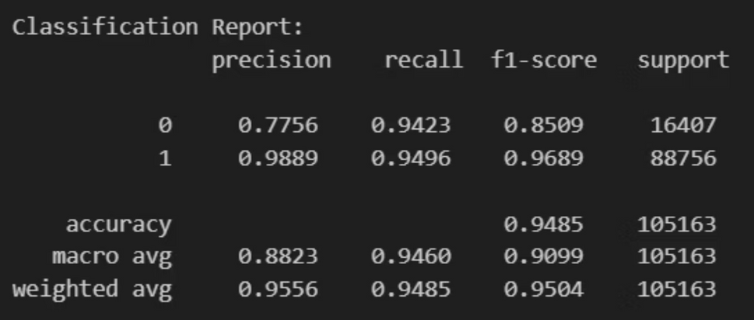
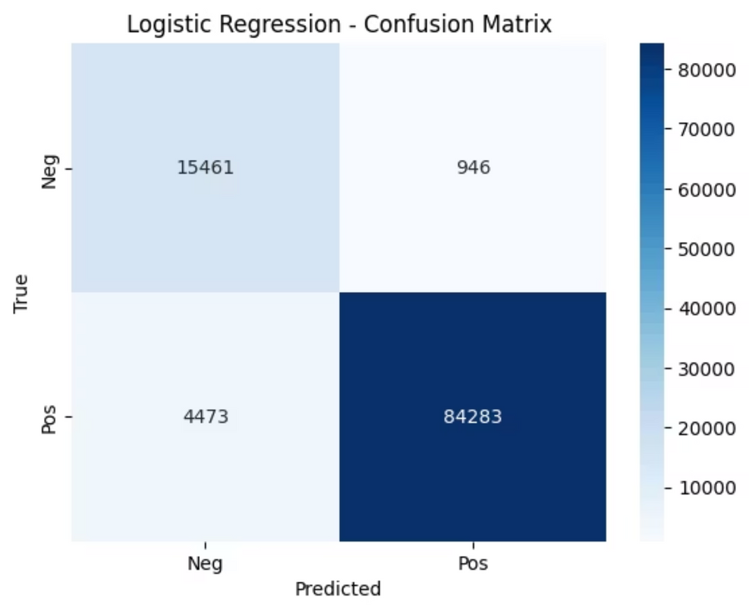
Evaluation and Metrics
Uses a class_weight = 'balanced' to handle the imbalance in dataset so model automatically assigns higher weights to minority classes and lower weights to majority classes.
ROC-AUC Score: 0.986 – Indicating the model has an extremely high ability to distinguish between positive and negative sentiment without confusion.
Notes:
11

Slide 12
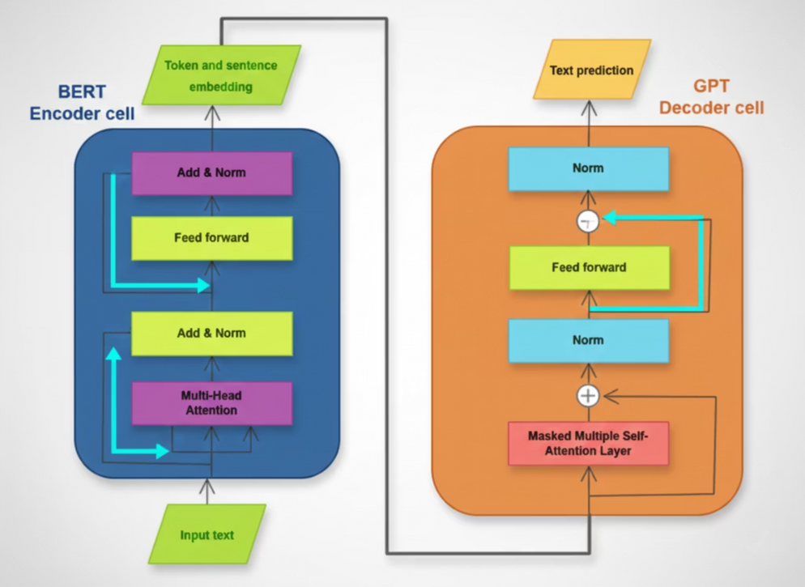
Summarization
Summarization condenses long texts into shorter, accurate versions by extracting key information, crucial for managing information overload in the digital age, primarily through Extractive (picking key sentences) and Abstractive (generating new sentences) methods.
Utilized BART (Bidirectional and Auto-Regressive Transformers), specifically trained on large-scale news datasets (CNN/Daily Mail) for high-quality summarization.
Employs a bidirectional encoder to understand the full context of a review and a decoder to generate a fluent, readable summary.
The encoder analyzes the input tokens, in both directions. This enables the encoder to understand how different tokens in the input sequence are related to each other .
The decoder operates as a right Transformer processing the output tokens sequentially. This ensures that the decoder generates an output sequence that makes sense and flows coherently.
Notes:
12

Slide 13
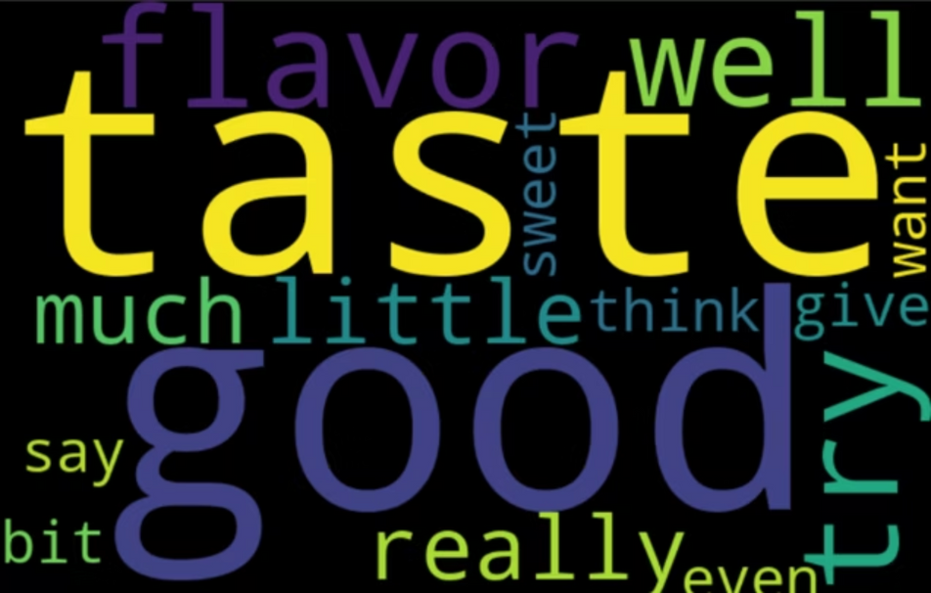
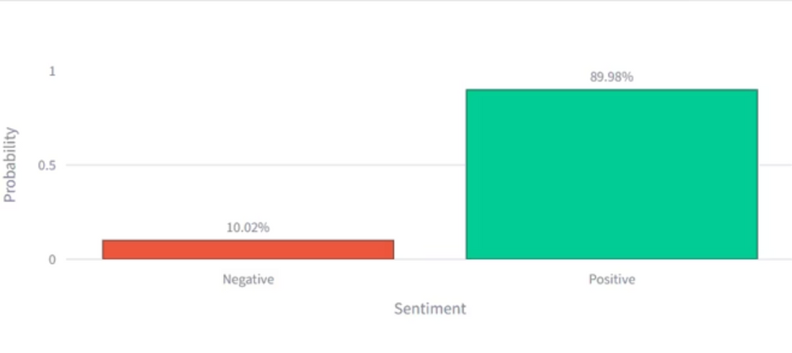
Visualizing the Story
Interactive dashboards transform complex data into intuitive visuals, making insights accessible and actionable for all stakeholders.
Word Clouds
Sentiment Bar Charts
Representing key themes and frequently occurring terms.
Visualizing the distribution of emotional tones across topics.
Notes:
13

Slide 14
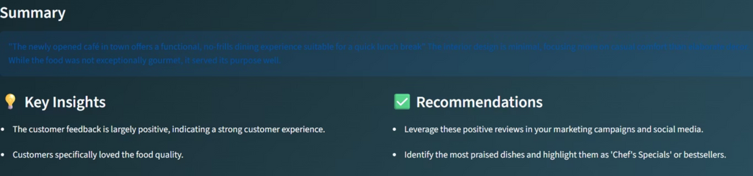
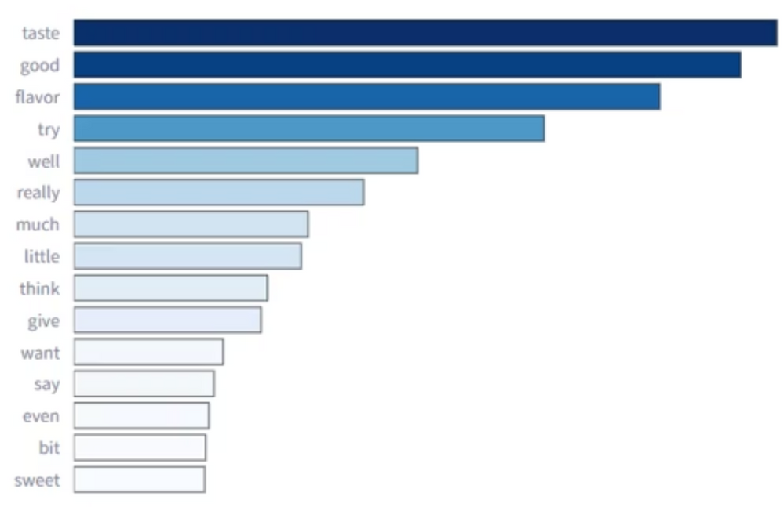
Interactive Dashboards
Key terms in Dominant topic
Summary, Insights and Recommendations
Reporting Module
Generate comprehensive reports summarizing the findings, including actionable insights and recommendations based on the analysis and providing users an option download the reports.
Notes:
14

Slide 15
Future Scope and Strategic Enhancements
Deep Learning Upgrades: Transitioning from Logistic Regression to BERT or RoBERTa for sentiment analysis to better capture sarcasm and complex emotional context through deep contextual embeddings.
Fine-Tuning the BART Model: Training the summarization engine specifically on the Amazon Fine Food corpus rather than general news data to improve domain-specific vocabulary and reduce "extractive" tendencies.
Multi-Lingual Support: Expanding the NLP pipeline to process reviews in multiple languages, allowing for global brand monitoring across international markets.
Real-Time API Integration: Deploying the model via FastAPI or Flask to allow businesses to pipe live customer reviews directly into the dashboard for immediate analysis.
Conclusion
In this project, we developed a dynamic text analysis platform that provides valuable insights by extracting themes and summarizing text data. By leveraging advanced algorithms and user-friendly design, this platform aims to serve a wide range of users, enhancing their ability to make informed decisions based on textual information. Ultimately, this tool serves as a bridge between massive, unstructured data uploads and actionable decision-making, allowing users to uncover the "voice of the customer" in seconds with mathematical precision and human-like clarity.
Notes:
15

Slide 16
Thank You
Notes:
16

